Slide 1
DATA ANALYTICS PROJECT
Hospitality Analytics
Hotel Performance Analysis
EXCEL
MySQL
TABLEAU
POWER BI
POWER QUERY
GROUP 2
Project Team — 4 Members & Roles
Chetan Kare — Business Analyst
Rohit Chauhan — Data Analyst
Shravani Biradar — Data Analyst
Shaikh Momin — Data Analyst
Hospitality Analytics | Hotel Performance & Revenue Analysis | May–July

Slide 2
OBJECTIVE
Hospitality Analytics
The main objective of this project is to analyze hotel booking data and understand the overall performance of the hotels. We focused on important areas such as revenue, bookings, occupancy, cancellations and room performance. We also used Excel, SQL, Power BI and Tableau to analyze the data, create dashboards and identify useful insights that can help in better decision-making.
Hospitality Analytics | Hotel Performance & Revenue Analysis | Group 2

Slide 3
PROJECT OVERVIEW
About Hospitality Analytics
Our project is about Hospitality Analytics. In this project, we studied hotel booking data to understand the overall hotel performance.
We looked at revenue, bookings, occupancy, cancellations, room capacity, and booking status.
We used Excel and MySQL to prepare and analyze the data. We used SQL queries to calculate important KPIs like Total Revenue, Total Bookings, Occupancy, Cancellation Rate, ADR, and RevPAR.
After analyzing the data, we created dashboards using Power BI and Tableau. We used different charts and KPI cards to show the results clearly.
This dashboard helps us understand hotel performance, booking trends, and revenue, and makes it easier to take better business decisions.
25%
135K
1026
Hospitality Analytics | Hotel Performance & Revenue Analysis | Group 2
2

Slide 4
PROJECT ROADMAP
Four phases, one end-to-end analytics workflow
01
02
03
04
Excel
Tableau
Power BI
MySQL Workbench
Data cleaning, data formatting, duplicate checking and basic data preparation for analysis.
Used Power Query, data modeling, and charts to create an interactive dashboard.
Created KPI cards, charts, filters and an interactive dashboard to analyze hotel revenue, bookings, occupancy and other performance metrics.
Imported the prepared data, created tables and used SQL queries, joins and aggregate functions to calculate important hospitality KPIs.
Hospitality Analytics | Hotel Performance & Revenue Analysis | Group 2
3

Slide 5
DATASET OVERVIEW
Fact and dimension tables used for hospitality analysis
TABLE
PURPOSE
STAR-SCHEMA MODEL
fact_bookings
Booking transaction details
Fact_Booking
fact_aggregated_bookings
Successful bookings and room capacity
Dim_date
Dim_date
Date and week information
Dim_hotels
Dim_hotels
Hotel and city details
Dim_rooms
Dim_rooms
Room class details
Fact Aggregated Bookings — Booking Performance & Capacity
Hospitality Analytics | Hotel Performance & Revenue Analysis | Group 2
4

Slide 6
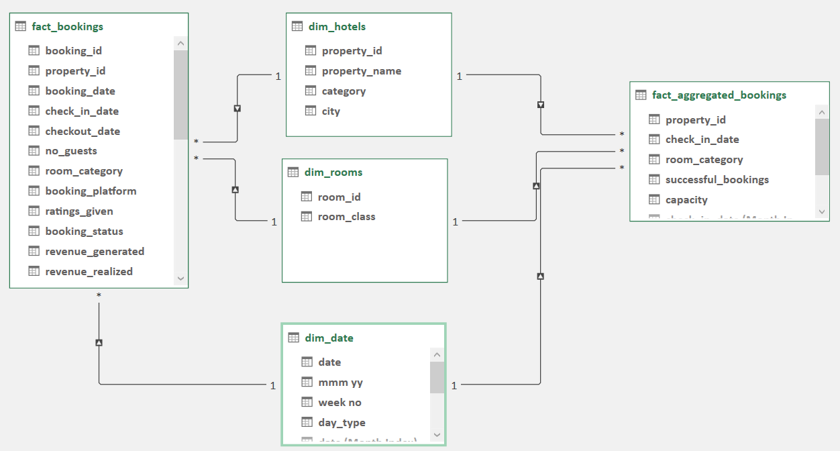
HOSPITALITY ANALYTICS DATA MODELING
Star-schema relationships linking the Booking fact table to three dimension tables
2 Fact Table • Bookings
3 Dimension Tables
Star-Schema Design
Hospitality Analytics | Hotel Performance & Revenue Analysis | Group 2
5

Slide 7
DATA PREPARATION
Data Preparation — cleaning, validation & formatting
1
2
3
Data Cleaning
Data Validation
Date Types
We removed duplicate and incorrect records and made the data ready for analysis.
We checked for missing values, duplicates, and any data errors.
We Checked and corrected data types for dates, numbers and text fields for accurate analysis.
4
5
6
Date Fields
Data Organization
KPI Preparation
We Used check-in dates and week numbers to analyze weekly booking and revenue trends.
We Organized the data into fact and dimension tables for easier SQL analysis.
We Prepared data for important KPIs such as Revenue, Bookings, Occupancy, ADR and RevPAR.
Hospitality Analytics | Hotel Performance & Revenue Analysis | Group 2
6

Slide 8
PROJECT QUESTIONNAIRE
Key tasks performed in the hospitality analytics workflow
Data Preparation & KPI Calculations
Visual Analysis
KPIs & Dashboard
Calculate Total Revenue
Calculate Total Bookings
Calculate Occupancy %
Calculate Cancellation Rate
Calculate No Show Rate
Calculate Realisation %
Calculate ADR
Calculate RevPAR
Revenue by City
Revenue by Hotel
Revenue by Room Class
Booking Status
Weekly Revenue Trend
Weekday vs Weekend Analysis
Calculate ADR, RevPAR, DBRN, DSRN & DURN.
Analyze Week-over-Week (WoW) performance.
Create KPI cards and interactive dashboards.
Identify key hotel performance insights.
Hospitality Analytics | Hotel Performance & Revenue Analysis | Group 2
7

Slide 9
HOSPITALITY SQL ANALYSIS
MySQL Workbench — Analyzing hospitality data using SQL
SELECT, SUM, COUNT, JOIN, GROUP BY, CASE and LAG() used for KPI and performance analysis
Data Foundation
Calculated Fields
Chart-Ready Queries
KPI Queries
Imported hotel booking data and organized it into fact and dimension tables.
Calculated Total Revenue, Total Bookings and Total Successful Bookings.
Revenue by City and Hotel
25 Hospitality KPIs calculated using SQL
Revenue by Room Class
Used fact_bookings for booking and revenue analysis.
Calculated Occupancy %, Cancellation %, No Show % and Realisation %.
Revenue, Occupancy, ADR and RevPAR analysis
Booking Status Analysis
Used fact_aggregated_bookings for successful bookings and room capacity.
Calculated ADR, RevPAR, DBRN, DSRN and DURN.
DBRN, DSRN and DURN calculations
Weekday vs Weekend Revenue and Bookings
Revenue, Occupancy, ADR, RevPAR and DSRN WoW Change %
Weekly Revenue, Bookings and Occupancy Trends
Hospitality Analytics | Hotel Performance & Revenue Analysis | Group 2
8

Slide 10
ADVANCED SQL ANALYTICS
WEEK-OVER-WEEK SQL ANALYSIS
1
Revenue WoW Change %
2
Occupancy WoW Change %
3
ADR WoW Change %
LAG() is used to compare current week revenue with the previous week and calculate the revenue change percentage.
Compares current week occupancy with the previous week to identify changes in hotel room utilization.
Compares current week ADR with the previous week to identify changes in average daily room rates.
LAG(revenue) OVER (ORDER BY week_no)
LAG(occupancy) OVER (ORDER BY week_no)
LAG(ADR) OVER (ORDER BY week_no)
4
RevPAR WoW Change %
5
DSRN WoW Change %
6
SQL Function Used — LAG()
Compares current week RevPAR with the previous week to measure changes in revenue generated per available room.
Compares current week DSRN with the previous week to identify changes in daily sellable room nights.
LAG() retrieves the previous week's value, which is used to calculate the Week-over-Week change percentage.
LAG(RevPAR) OVER (ORDER BY week_no)
LAG(DSRN) OVER (ORDER BY week_no)
LAG()
Hospitality Analytics | Hotel Performance & Revenue Analysis | Group 2
9

Slide 11
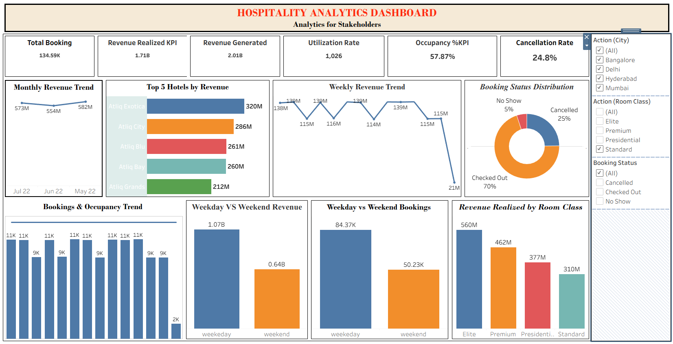
TABLEAU DASHBOARD I
Hotel revenue and booking performance analysis
Visualizations Used
KPI Cards
Total Booking, Revenue Realized, Occupancy & Cancellation Rate , Utilization Capacity
Bar + Line Combo
Revenue, Total Booking and Occupancy weekly trend.
Donut Chart
Booking Status Distribution — Checked Out, Cancelled & No Show.
Line Chart
Monthly Revenue Trend, Weekly Revenue Trend.
Bar Chart
Top 5 Hotels by Revenue..
Column Chart
Weekday vs Weekend Revenue and Weekday vs Weekend Bookings, and Revenue Realized by room class
Slicers
City, Room Class and Booking Status for interactive analysis.
Hospitality Analytics | Hotel Performance & Revenue Analysis | Group 2
10

Slide 12
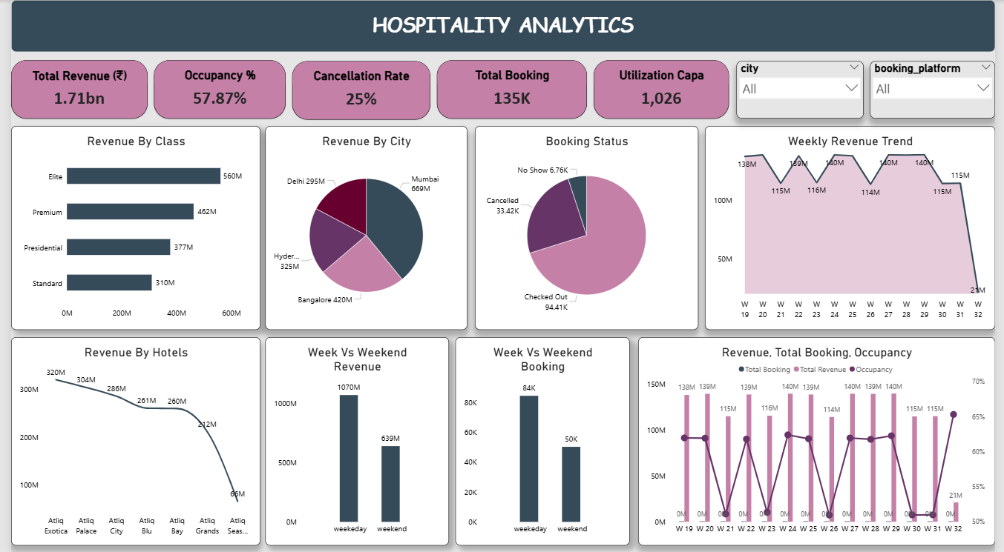
POWER BI DASHBOARD II
Hotel performance analysis with interactive filters
Visualizations Used
KPI Cards
Total Booking, Revenue Realized, Revenue Generated, Revenue Loss, Occupancy & Cancellation Rate.
Bar Chart
Revenue Realized by Room Class.
Line chart
Monthly Revenue Trend and Revenue by Hotels.
Column Charts
Weekday vs Weekend Revenue and Weekday vs Weekend Bookings.
Pie Chart
Booking Status and Revenue by City..
Combo Chart
Revenue, Total Booking and Occupancy trend.
Slicers
City and booking_platform.
Hospitality Analytics | Hotel Performance & Revenue Analysis | Group 2
11

Slide 13
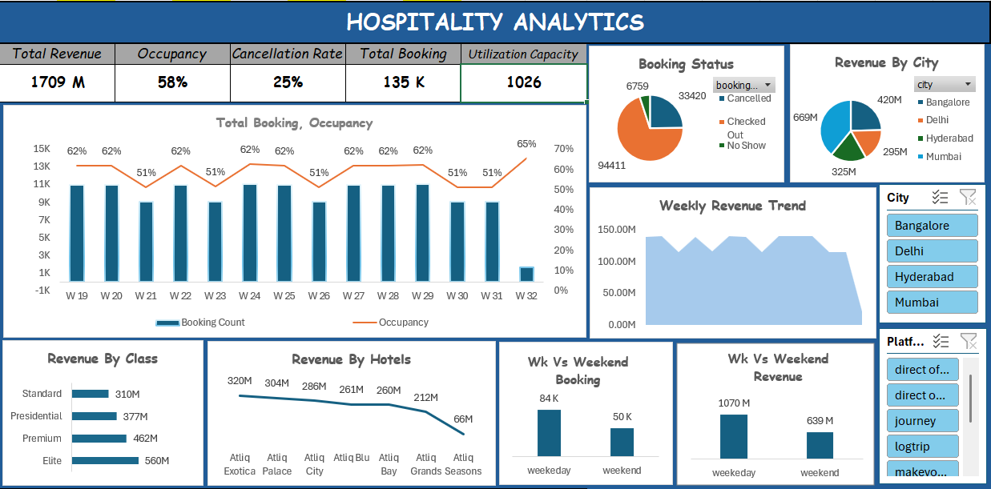
EXCEL DASHBOARD III
Hotel performance overview — revenue, bookings & occupancy
Visualizations Used
KPI Cards
Total Revenue, Occupancy, Cancellation Rate, Total Booking & Utilization Capacity.
Bar Chart
Revenue by Room Class.
Line Chart
Revenue by Hotels and Weekly Revenue Trend.
Pie Chart
Booking Status and Revenue by City.
Column Chart
Weekday vs Weekend Booking and Revenue.
Combo Chart
Weekly Revenue/Booking with Occupancy trend.
Hospitality Analytics | Hotel Performance & Revenue Analysis | Group 2
12

Slide 14
KEY INSIGHTS
Hotel Performance & Revenue Analysis | May - July
1.71B
135K
57.87%
25%
1026
TOTAL REVENUE
TOTAL BOOKING
OCCUPANCY %
CANCELLATION RATE
UTILIZATION CAPACITY
1
Revenue Performance
2
Occupancy
3
Booking Performance
Revenue helps us understand the overall financial performance of the hotels , like how much money the hotels are earning.
Occupancy shows how many available rooms are occupied.
Total bookings help us understand customer demand , it show how many bookings the hotels received.
4
Cancellation
5
Weekly Trend
6
Room Class
Cancellation rate helps identify the level of booking cancellations , such as it shows how many bookings were cancelled.
Weekly trends show how hotel performance changes each week.
Room class analysis shows which room category earns more revenue.
Hospitality Analytics | Hotel Performance & Revenue Analysis | Group 2
13

Slide 15
What We Observe
What we found from the data
1. Occupancy is 58% which is less
2. Cancellation is 25% which is more
3. Revenue is dropping every alternate week
4. Atliq is the lowest (Too low)
5. Average rating 3.6
6. Atliq Exotica & Atliq Palace are top 2 contributors in *cancellation* . Atliq Exotica from Mumbai is 12% is the contributor
7. Atliq Season, Mum is the *least average rating* with 2.3, Followed by Exotica, Hyd with 2.3
Hospitality Analytics | Hotel Performance & Revenue Analysis | Group 2

Slide 16
CHALLENGES WE FACE
Main challenges during our project
1
Lack of Communication
2
Unclear Goals
3
Responsibility Distribution
In the beginning, there was some communication gap in our team.
Later, we discussed things properly and worked together.
At first, we were not fully clear about what we needed to do.
After discussing the requirements, our goals became clear.
Dividing the work among team members was a little difficult.
We later divided the tasks based on each person's work.
4
Report Accuracy
5
Loading Tables to SQL
6
Choosing the Right Visual
We had to make sure that all the numbers and KPIs were correct.
So, we checked the report results with the original data.
While loading the tables into SQL, we faced some data type issues.
We checked and corrected the data types before loading the data.
Choosing the right visual for each KPI was also a challenge.
We selected visuals that made the data easy to understand.
Hospitality Analytics | Hotel Performance & Revenue Analysis | Group 2
6

Slide 17
RECOMMENDATIONS
Suggestions for Better Performance
1.
Improve Occupancy : Give offers and discounts when occupancy is low.
2.
Optimize Room Pricing : Change room prices based on demand and performance.
3.
Focus on High-Performing Hotels : Learn what successful hotels are doing and apply similar ideas to other hotels.
4.
Improve Low-Performing Hotels : Find out why some hotels have low revenue or occupancy and improve those areas.
5.
Reduce Cancellations : Use reminders and better booking policies to reduce cancellations.
6.
Optimize Booking Platforms : Focus more on platforms that bring good bookings.
7.
Weekday & Weekend Strategy : Use different offers for weekdays and weekends based on demand.
8.
Promote High-Performing Rooms : Promote room types that get more bookings and revenue.
Hospitality Analytics | Hotel Performance & Revenue Analysis | Group 2

Slide 18
THANK YOU
Hospitality Analytics — Hotel Performance Analysis
Excel • SQL • Tableau • Power BI

